Slide 1
Literature Review Papers

Slide 2

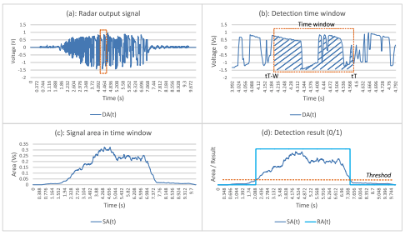
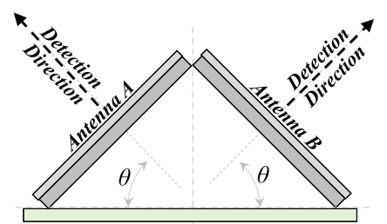
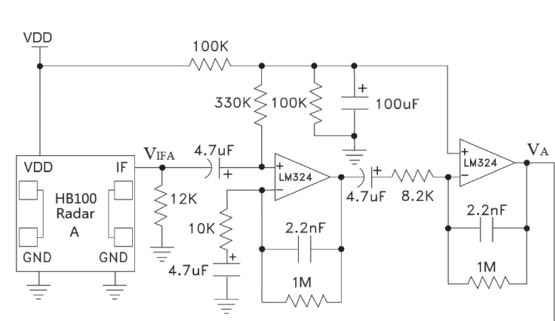
HB100 for Parking Lot Occupancy Detection
Used a combination of two HB100 radars
Designed to be placed on the ground in the parking bay
Detects whether a car is driving into, out of, or is parked in the bay depending on which radar detects the car and in what order
Doesn’t give any information on the type of vehicle in the bay

Slide 3
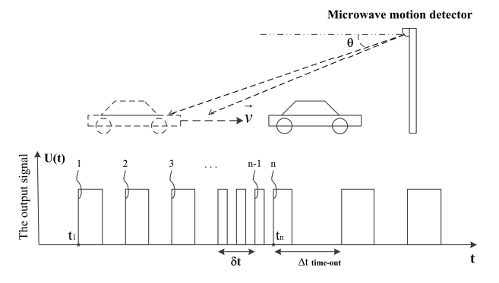
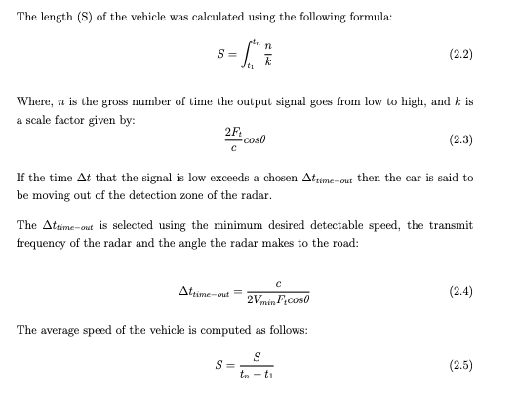
Vehicle Length and Speed Detection using HB100
Uses a single HB100 radar placed in the center of a lane above the road
Detects vehicles up to 8m away and moving at speeds ranging 5-40km/h
Had an accuracy of 80% detecting trucks, buses and cars
Use a similar amplifier as previous slide

Slide 4
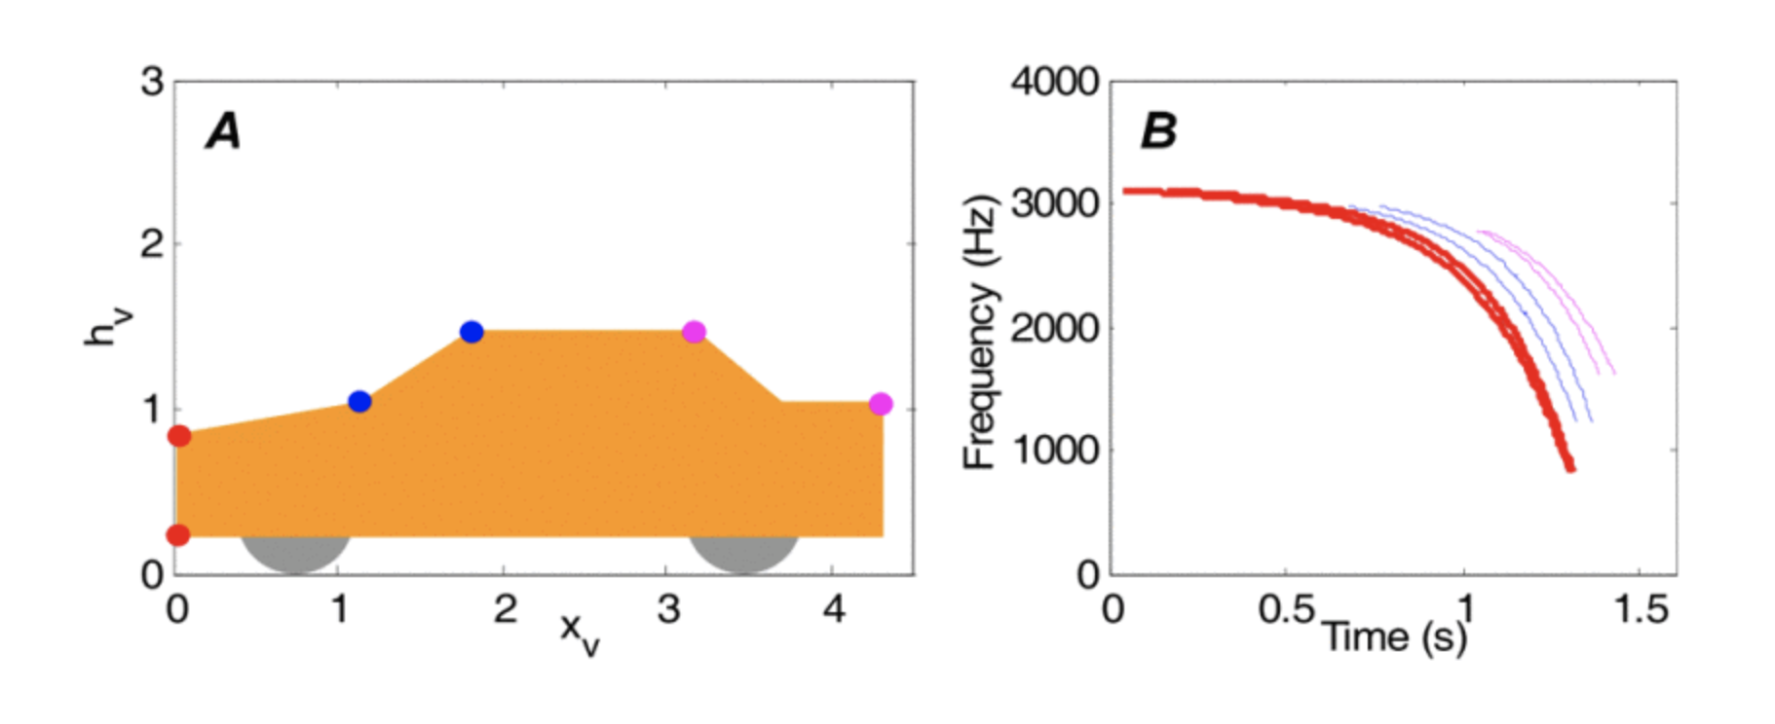
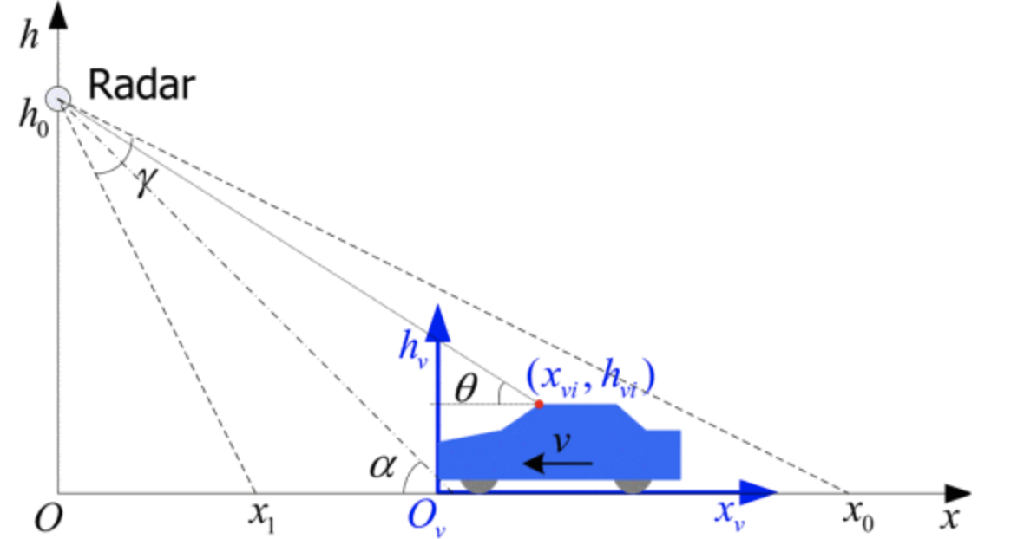
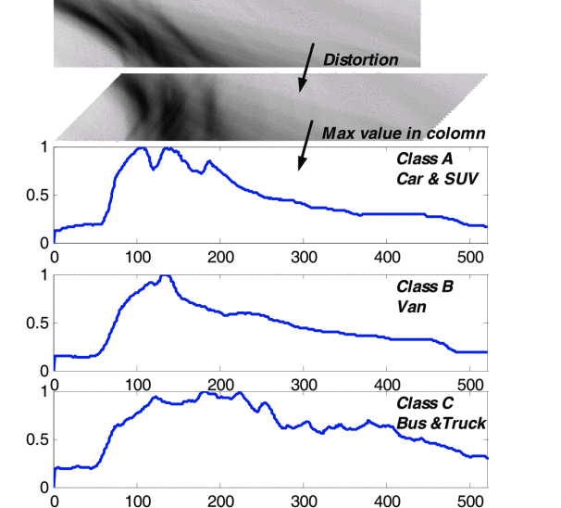
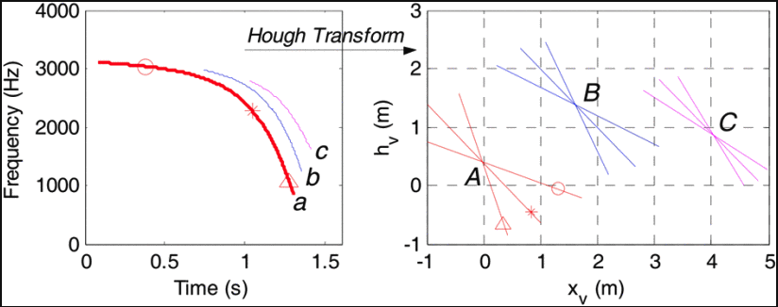
Low-Cost Vehicle Detection and Classification using CW Radar
Costs less than $250
Uses the different scatterings reflected off of different points on the car to identify the type of car
Uses a Hough transform to move from time frequency plot to height vs xpos plot.
CNN used to classify the vehicle type from the Hough transform

Slide 5
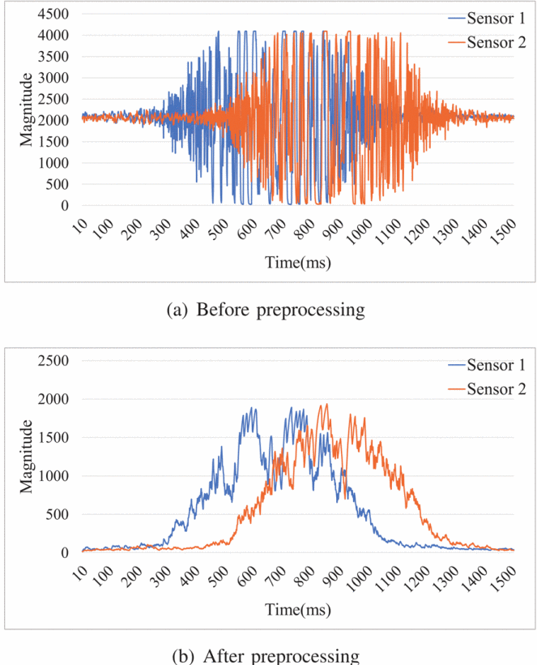
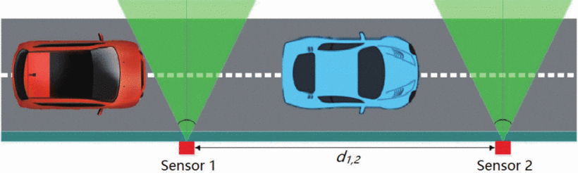
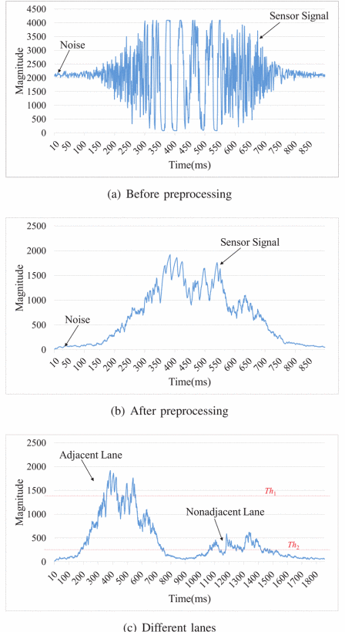
A Novel Cost Effective IoT-Based Traffic Flow Detection Scheme for Smart Roads
Uses CDM324 Microwave Radar
Thresholding and low pass filtering to reduce the effect of noise
Uses the time difference between sensor 1 detecting the vehicle and sensor 2 detecting the vehicle to estimate its speed
Was only testing on 1 lane detection
Achieved speed accuracy of 95.8% and detection accuracy of 98.3%
Very affordable, uses a $2.3 radar and a $1.7 ARM chip for processing

Slide 6
LoRa
Can transmit over very long ranges and consumes little power
Can work with just two LoRa modules which communicate between each other.
Can also use LoRaWAN which uses gateways that connect to a central network server using internet (might not be feasible in South Africa where there a limited/no existing LoRa gateways to connect to).
Limited data rates 0.3kbps – 11kbps.

